Slide 1
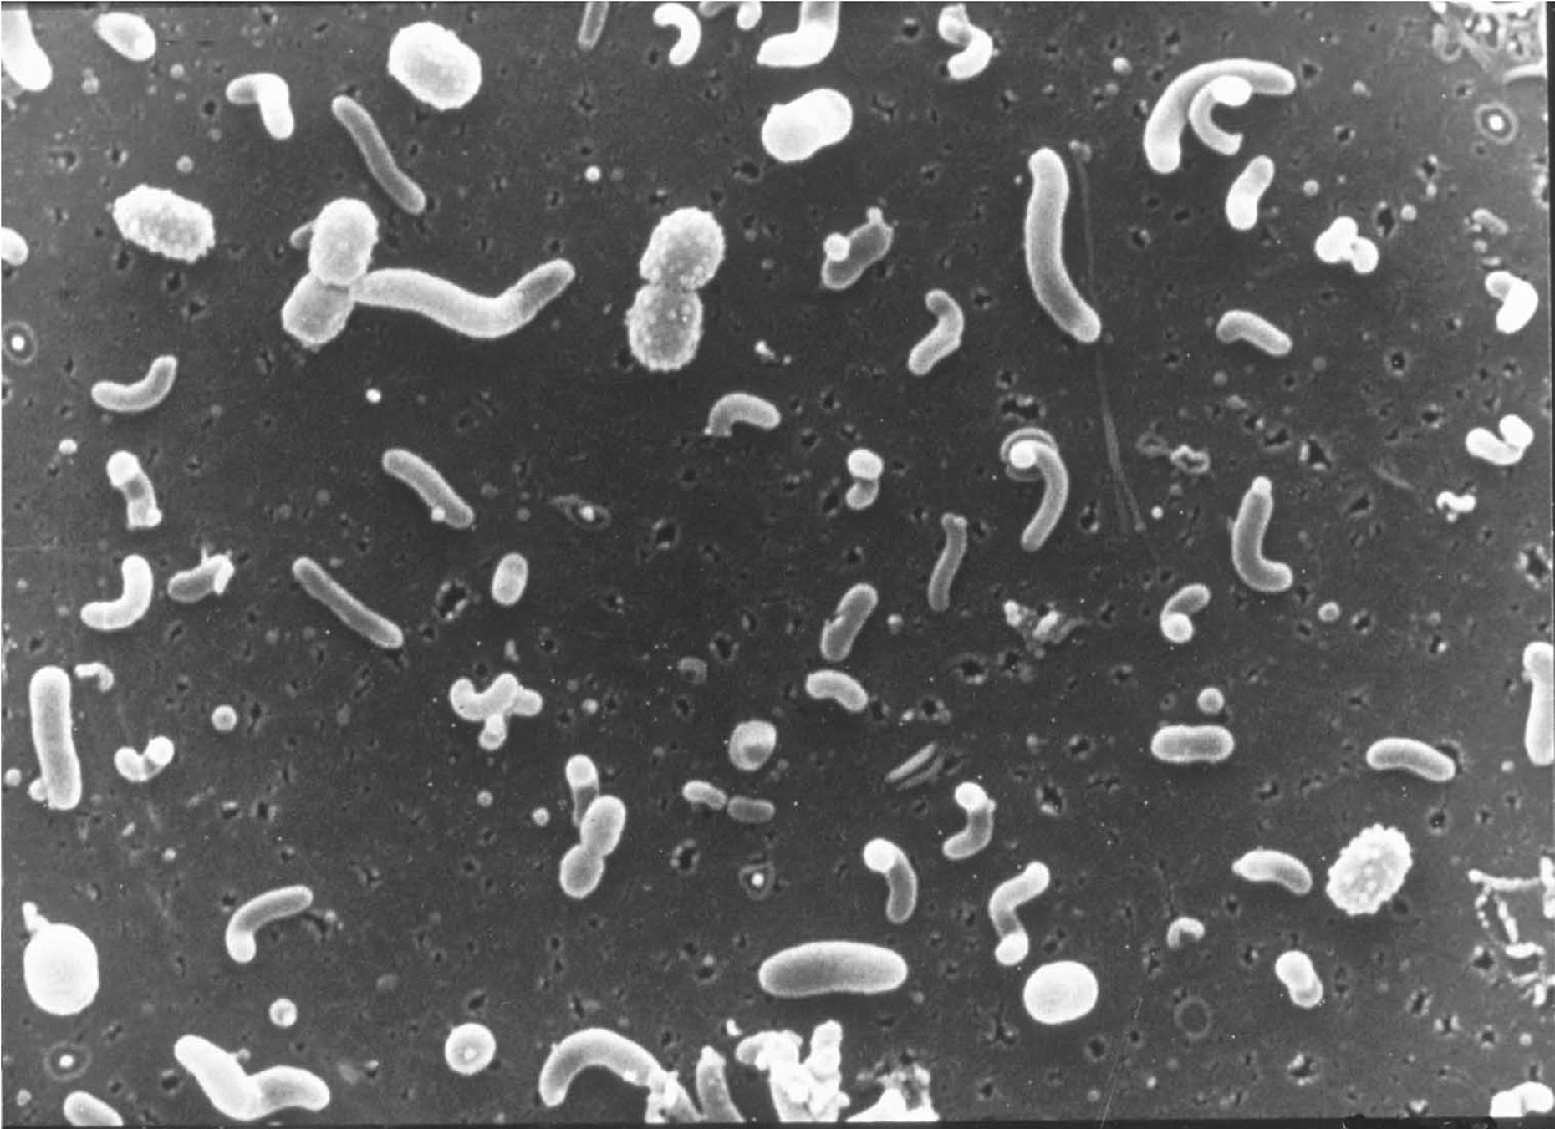
Analysis of environmental genomes using Pathway Tools
Steven Hallam | University of British Columbia
Hydrocarbon MetaPathways Tutorial, 2014

Slide 2
Overview
Through the looking glass…
MetaPathways Pipeline Development
Hawaii Ocean Time Series

Slide 3
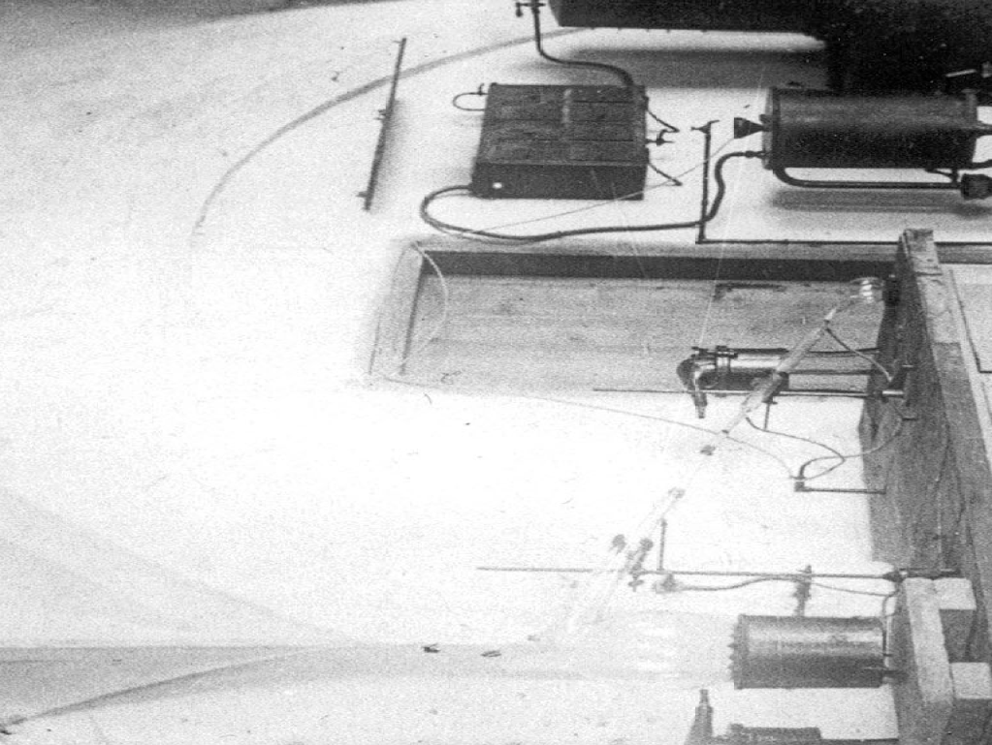
1869
Notes:
Johannes Friedrich Miescher (MEEscher) isolated various phosphate-rich chemicals, which he called nuclein (now nucleic acids), from the nuclei of white blood cells in 1869 at Felix Hoppe-Seyler's laboratory at the University of Tübingen, Germany,

Slide 4
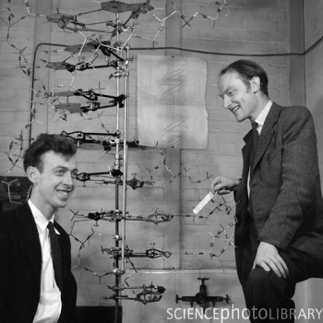
1953
Notes:
James D. Watson and Francis Crick grin over the structure of B-Form DNA in 1953

Slide 5
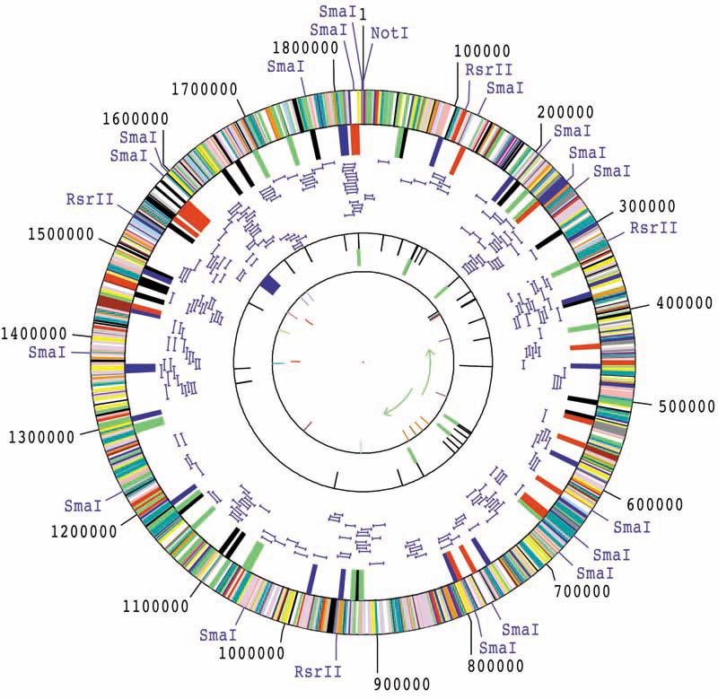
1995
Haemophilus influenzae
Notes:
Fleischmann R, Adams M, White O, Clayton R, Kirkness E, Kerlavage A, Bult C, Tomb J, Dougherty B, Merrick J (1995). "Whole-genome random sequencing and assembly of Haemophilus influenzae Rd". Science 269 (5223): 496–512. Bibcode 1995Sci...269..496F. doi:10.1126/science.7542800. PMID 7542800.
Whole-genome random sequencing and assembly of Haemophilus influenzae Rd.
Fleischmann RD, Adams MD, White O, Clayton RA, Kirkness EF, Kerlavage AR, Bult CJ, Tomb JF, Dougherty BA, Merrick JM, et al.
Source
Johns Hopkins University School of Medicine, Baltimore, MD 21205, USA.
Abstract
An approach for genome analysis based on sequencing and assembly of unselected pieces of DNA from the whole chromosome has been applied to obtain the complete nucleotide sequence (1,830,137 base pairs) of the genome from the bacterium Haemophilus influenzae Rd. This approach eliminates the need for initial mapping efforts and is therefore applicable to the vast array of microbial species for which genome maps are unavailable. The H. influenzae Rd genome sequence (Genome Sequence DataBase accession number L42023) represents the only complete genome sequence from a free-living organism.

Slide 6

Sequencing Innovation
1,000,000,000
The Great Wave off Kanagawa _{Hokusai}
Short-read
sequencers
100,000,000
10,000,000
Microwell
pyrosequencing
1,000,000
Second-generation
capillary
100,000
Kilobasess per day per machine
10,000
Automatedslab gel
1,000
Manual
slab gel
First-generation
capillary
100
10
1980
1990
2000
2010
Genomes
H. influenzae
H. Sapiens
GOS
Notes:
Compare with Moore’s Law

Slide 7

Notes:
A symbolic representation of metabolism is one recognized by both human beings and computers…

Slide 8

Notes:
Our contemporary world image resolves a complex and dynamic planet, in some sense a living organism.
http://en.wikipedia.org/wiki/The_Blue_Marble
The snapshot—taken by astronauts on December 7, 1972, at 5:39 a.m. EST (10:39 UTC)—is one of the most widely distributed photographic images in existence.[2] The image is one of the few to show a fully illuminated Earth, as the astronauts had the Sun behind them when they took the image. To the astronauts, Earth had the appearance and size of a glass marble, hence the name.

Slide 9
Notes:
Sargasso Sea bacterioplankton. Ed Delong prepared them as a postdoc in Norm Paces lab in 1989. And there is a funny story. Norm had been nagging everyone in the lab "you have to use Cel Tak !" (a molecular glue they extract from the byssal threads of mussels). So, I took him up on it. These were cells that had been concentrated by tagential flow filtration, and glutaraldehye fixed. The concentrated cells were placed on a coverslip, allowed to settle overnight, and the coverslip subjected to normal SEM sputtercoating etc.. (by an SEM expert who held my had through the process at Indiana University).

Slide 10
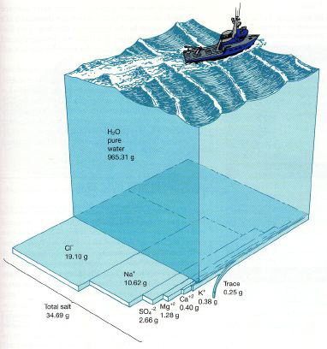
Like cells in a body…
~10⁶ bacterial cells per ml
Defined by genomic diversity and metabolic potential rather than morphological diversity

Slide 11
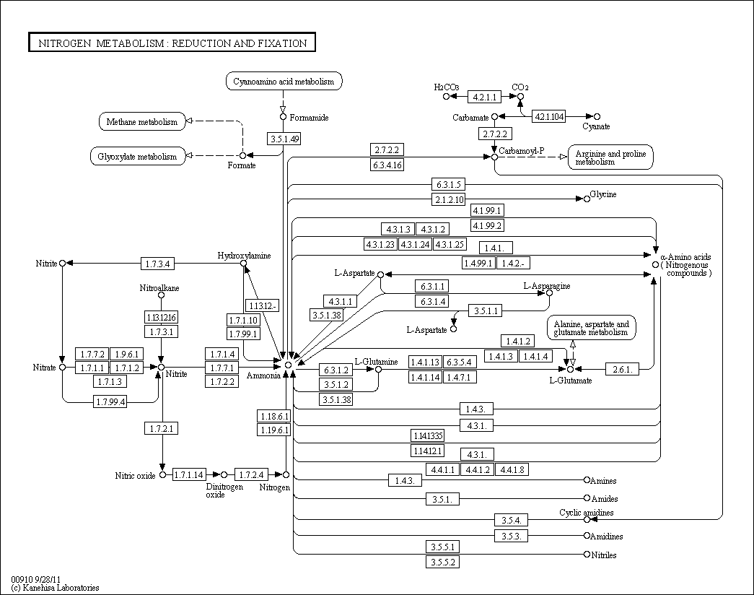
Metabolism
Vertex = chemical [substrate, product]
Edge = enzyme
Metabolism, or the synthesis and decomposition of chemicals in a cell can be organized into pathways represented by graphs.

Slide 12
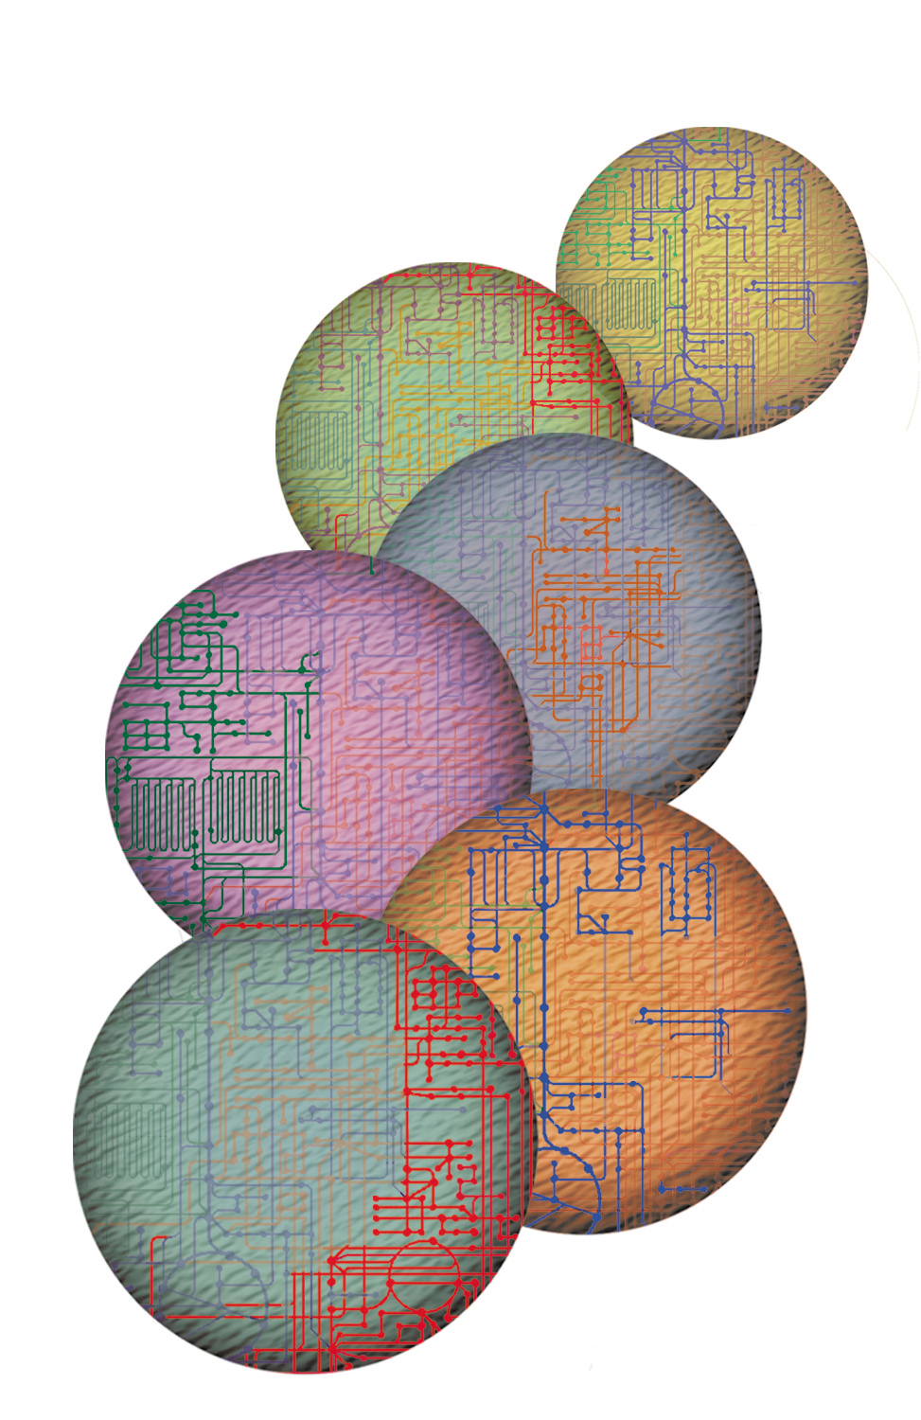
Cellular Pathways
Genome Management Information System, Oak Ridge National Laboratory
Our genetic and biochemical understanding of metabolism is based largely on the study of complete pathways within cells.

Slide 13
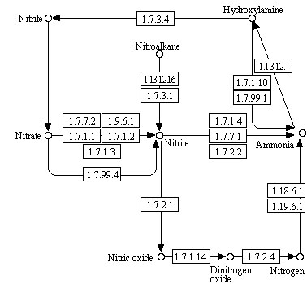
Distributed Pathways
However, microbial communities form distributed metabolic pathways directing matter and energy exchange.

Slide 14
Community Metabolism
The goal is to predict and compare distributed pathways to better understand coupled biogeochemical cycles in natural and human engineered ecosystems.

Slide 15
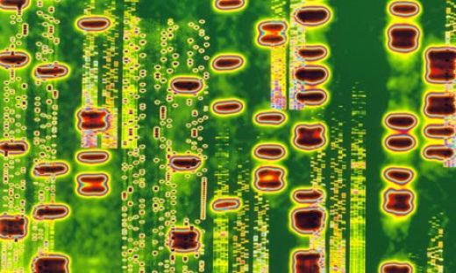
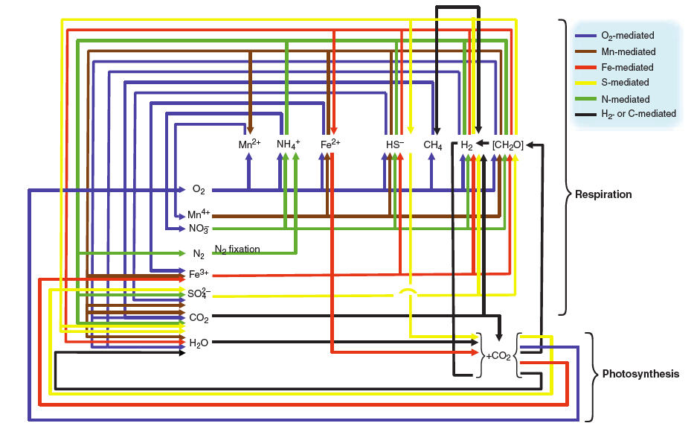
Through the Looking Glass…
Falkowski et al., (2008) Science 320, 1034-1038
Biological Information
Community Metabolism
Ecosystem Function
“The regulation of the pools and fluxes in biogeochemical cycles have their origins in the genetic inventory of individual microbes, and the regulation of these genes within the organism is determined by the environment. As such, one can look at the microbial food web as a collection of genomes whose expression and replication is coordinated through complex feedback loops at the organismal, population, and ecosystem level. “_{Chisholm}
Notes:
Quoting chisholm, carey NSF draft report, “The regulation of the pools and fluxes in biogeochemical cycles have their origins in the genetic inventory of individual microbes, and the regulation of these genes within the organism is determined by the environment. As such, one can look at the microbial food web as a collection of genomes whose expression and replication is coordinated 3/4 through complex feedback loops 3/4 at the organismal, population, and ecosystem level. As individual microbial genomes are mosaics of genes of mixed heritage, a microbial community is a collection of gene functions distributed amongst its individual members. No single organism contains all the genes necessary to perform the diverse biogeochemical reactions that make up ecological community function. Yet, distributed amongst the community, are all the functions necessary to define that community’s interaction with its environment. One of the novel disciplines that may arise from environmental genomics efforts is “genome ecology”. Conceptually, one can view the collective genomes from a given environment as a single unit, which can be compared directly with that derived from another habitat, or from the same environment at a different time. Is there a defined family of genomes (or genome contents) that defines the biome of a given environment (regardless of species composition)? As sequence sample size increases, does the quantity of genome contents increase proportionally? At what sample size is ‘genome content saturation’ reached for any given habitat? In a related sense, one might model the minimal collective ‘environmental genome’, in analogy to recent efforts to define the minimal genome of a free living microbe. Would this be the definition of the ‘minimum ecological unit’? These are profound questions, which until recently were completely outside our grasp.”

Slide 16
Foundational Questions
What is the taxonomic and functional structure of the ecosystem?
How does this structure change in response to environmental perturbation?
What are the ecological consequences of this change?
How can this information be used to develop biomarkers or models for monitoring industrial performance and environmental impacts?
Notes:
Here structure implies more than categorical definitions of taxon abundance or gene frequency to include the ecological relationships and regulatory networks between organisms, populations and communities.

Slide 17
l
G_{m} = ∑n_{i}G_{i}
i = 1
G_{m} = metagenome size in bases
l = number of genomes in sample
n_{i} = number of copies of genome G_{i}
G_{i} = size of any given genome in sample of l genomes
In any given metagenome sample genotypes appear at different frequencies (evenness). Therefore a metagenome of size Gm composed of genomes of sizes G_{i} through G_{k} can be viewed as a sum of fractions where each component genome of size G_{i} constitutes a fraction of G_{m:}
G_{m} = p₁G_{m} + p₂G_{m} + … + p_{l}G_{m}
ˆ

Slide 18
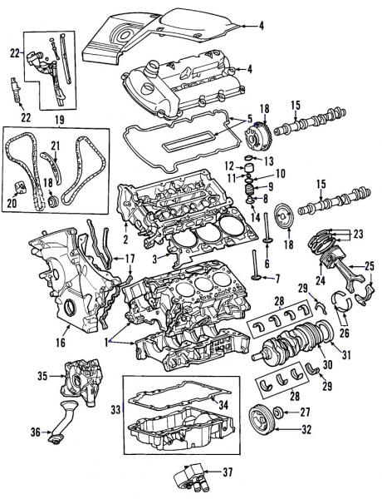
Parts
Molecular
Machines
Notes:
Application of environmental genomic techniques permits us to investigate microbial genomes in a community setting independent of cultivation. It is in effect like trying to put the pieces of many puzzles back together again after mixing them all together in one convoluted pile. One challenge among many imposed by this approach is the genomic variation within naturally occurring microbial populations. Another is the size of the puzzle pieces one tries to assemble.

Slide 19
Paths
Nitrogen Metabolism

Slide 20
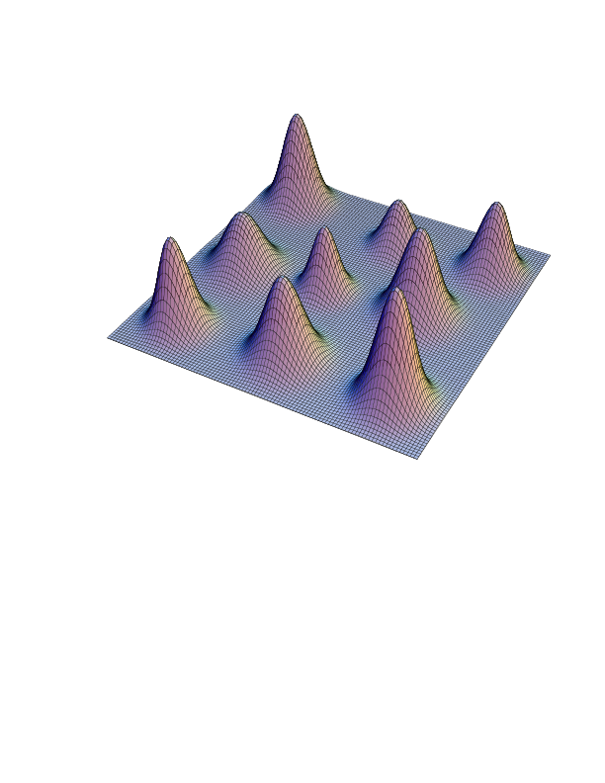
Panoramas
abundance
Path 3
Path 2
Taxon 1
Taxonomic or
Functional Bins
Taxon 2
Path 1
Taxon 3

Slide 21
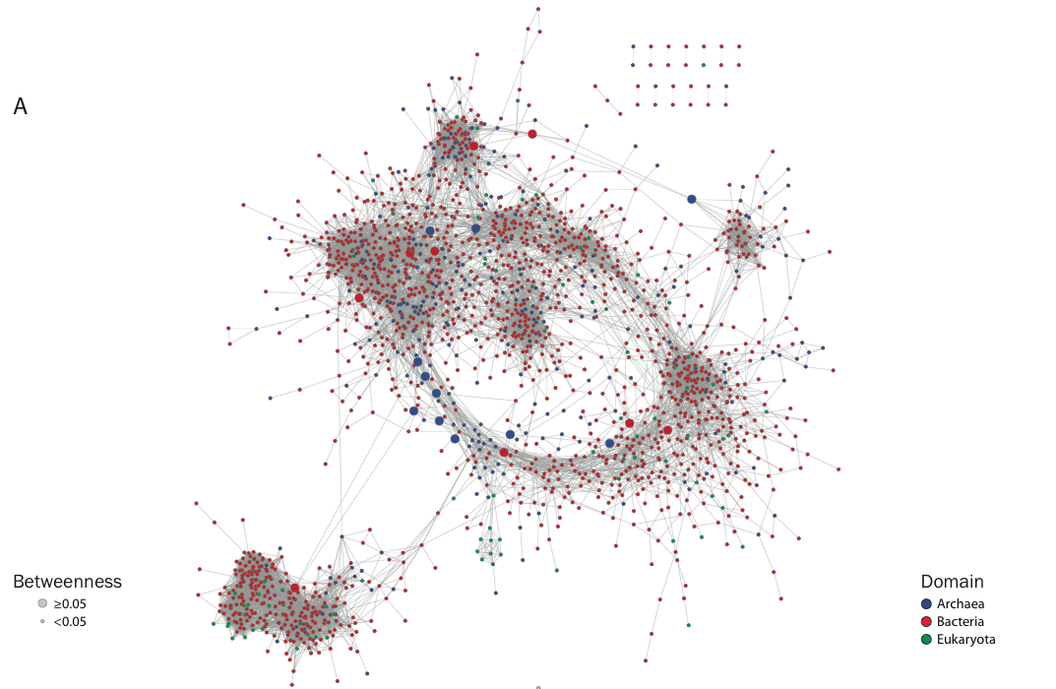

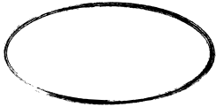
Co-occurrence Networks
Ecological
Interactions

Slide 22
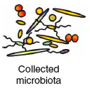
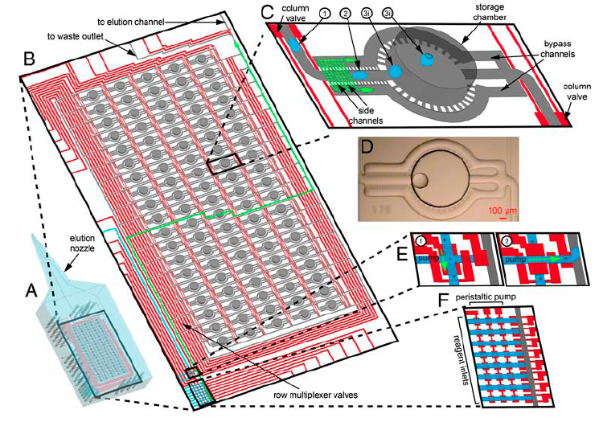
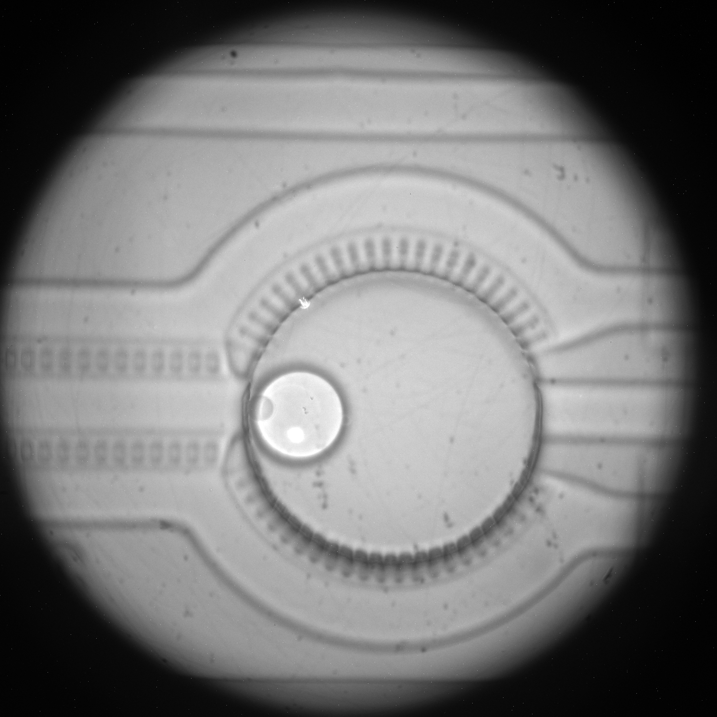
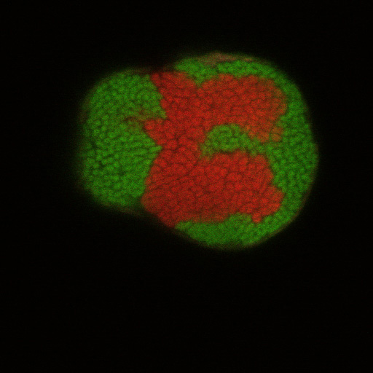
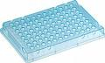
Single-cell Genomics
5 uM
WGA Archive
:eung et al. 2012 A programmable droplet-based microfluidic device applied to multiparameter analysis of single microbes and microbial communities

Slide 23
Predicting Community Metabolism
Plurality Sequencing
Single-Cell Sequencing
Taxonomic Binning
Pathway
Analysis
Simulated
Metagenome
Notes:
ePGDB = environmental pathway genome database

Slide 24
Overview
Through the looking glass…
MetaPathways Pipeline Development
Hawaii Ocean Time Series

Slide 25
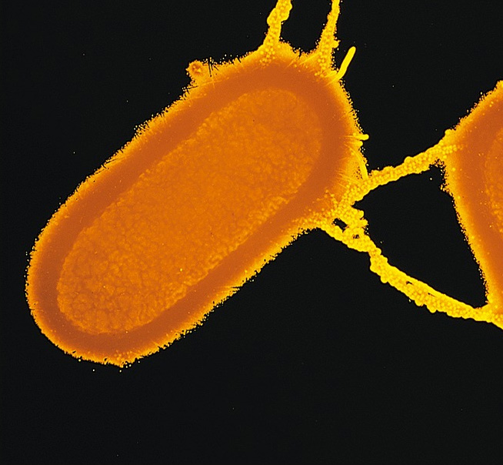
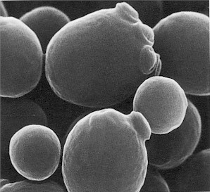
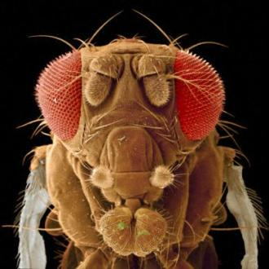
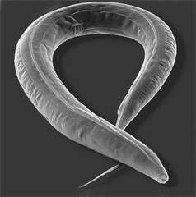
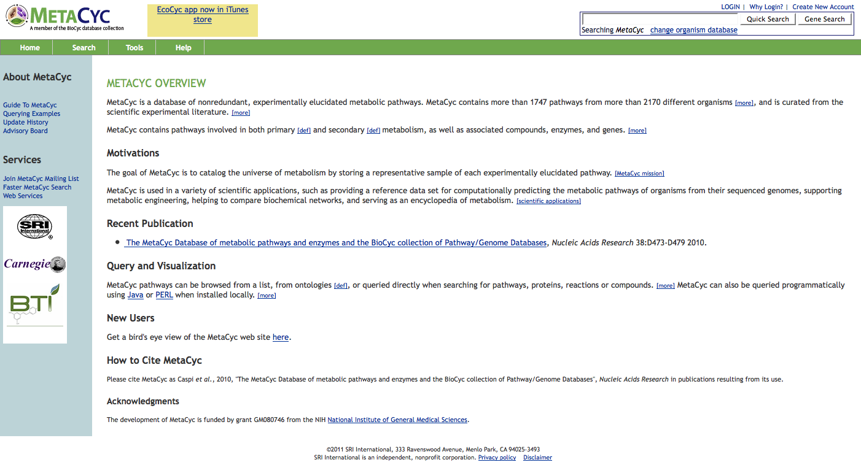

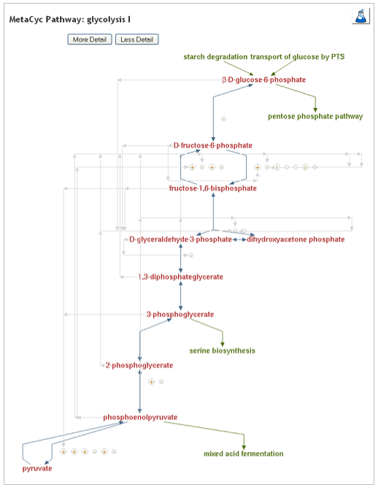
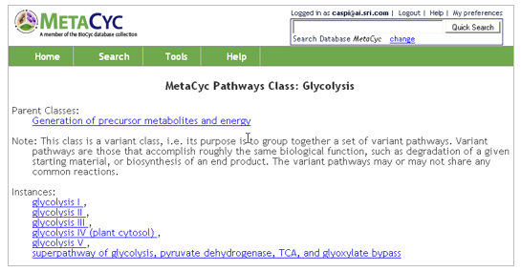
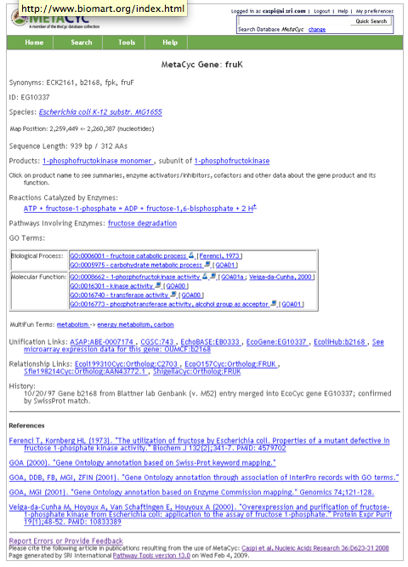
Pathway/Genome Database
Organisms
PGDB Navigator
Genomic Map
Genomic Map
Pathways
Genes/ORFs
Genes/ORFs
Reactions
Gene Products
Gene Products
Compunds
Pathologic*
PGDB
Compounds
Gene Products
Reactions
Genes/ORFs
Pathways
Genomic Map
* Integrates genome and pathway data to identify putative metabolic networks

Slide 26


http://biocyc.org/
The BioCyc collection of Pathway/Genome Databases (PGDBs) provides an electronic reference source on the genomes and metabolic pathways of sequenced organisms.
The BioCyc databases are divided into three tiers, based on their quality. Tier 1 databases have received person-decades of literature-based curation, and are the most accurate. Tier 2 and Tier 3 databases contain computationally predicted metabolic pathways, predictions as to which genes code for missing enzymes in metabolic pathways, and predicted operons.
Caspi, R. et al., 2008. The MetaCyc Database of metabolic pathways and enzymes and the BioCyc collection of Pathway/Genome Databases, Nucleic Acids Research , 36:D623-D631

Slide 27
http://metacyc.org/
MetaCyc is a multi-organismal member of the BioCyc collection that serves as a high-quality reference DB for predicting metabolic pathways in other organisms. MetaCyc entries are based on experimental evidence cited from literature searches.
MetaCyc does not seek to model metabolism of individual organisms, which is the role of individual BioCyc PGDBs.
MetaCyc contains 1,846 base pathways, compared to 179 pathway modules in KEGG. Furthermore MetaCyc assigns 10,262 reactions to pathways and contains over 36,796 pathway-associated literature citations.
Caspi, R. et al., 2008. The MetaCyc Database of metabolic pathways and enzymes and the BioCyc collection of Pathway/Genome Databases, Nucleic Acids Research , 36:D623-D631
Notes:
Scientists typically use MetaCyc to answer metabolic questions that span multiple domains of life, such as “what are all the pathways for arginine degradation in microbes,” or “what cofactor biosynthesis pathways are known in bacteria?” For questions that require information about the complete genome, proteome, or metabolic network of an organism, instead consult the organism-specific PGDB. For example, MetaCyc contains 14 pathways that have been experimentally studied in Staphylococcus aureus, and 36 enzymes that participate in these pathways. In contrast, the BioCyc Staphylococcus aureus RF122 PGDB contains 189 pathways (most of which are computationally predicted), plus the entire genome and proteome of that strain.
MetaCyc is a collaborative project between SRI International, the Boyce Thomson Institute for Plant Research, and the Carnegie Institution of Washington. Since its beginning in 1998, MetaCyc’s data have been gathered from a variety of literature and on-line sources. A staff of several full-time curators update MetaCyc on an ongoing basis using a literature-based strategy.

Slide 28
http://bioinformatics.ai.sri.com/ptools
Pathway Tools
PathoLogic: Creates a new PGDB containing the inferred metabolic pathways of an organism, given a Genbank entry as input.
Pathway/Genome Navigator: Supports query, visualization, and analysis of PGDBs.
Pathway/Genome Editors: Provide interactive editing capabilities for PGDBs.
MetaFlux: Supports flux balance analysis (FBA) modeling.
Karp, P.D. and Paley, S. and Romero, P.2002. The Pathway Tools Software. Bioinformatics, vol. 18, pp. S225-S232.

Slide 29
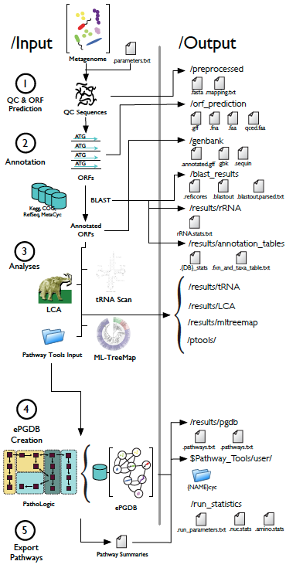
MetaPathways
A modular pipeline for constructing Pathway/Genome Databases (PGDBs) from environmental sequence information
MetaPathways currently supports four “data products” including i) GenBank submission, ii) LCA, iii) MLTreeMap, and iv) PGDBs with associated feature summary tables and GFF files
MetaPathways externalizes compute-intensive processes onto a user defined cluster using Sun Grid Engine or the Amazon elastic cloud
Konwar, K. M., N. W. Haetal., 2013. MetaPathways: A modular pipeline for constructing Pathway/Genome Databases from environmental sequence information. BMC Bioinformatics 21;14(1):202.

Slide 30
Environmental PGBDs
ePGDBs facilitate pathway-centric exploration of environmental sequence information using Pathway Tools and the MetaCyc web interface
Provides inference-based approach to metabolic reconstruction based on explicit computational rules to predict presence or absence of distributed metabolic networks
MetaPathways can be used with multi-molecular data sets (DNA, RNA or protein) sourced from cultured isolates, single-cells and natural or human engineered ecosystems
http://www.github.com/hallamlab/MetaPathways
http://hallam.microbiology.ubc.ca/MetaPathways

Slide 31
ePGDB Navigation

Slide 32
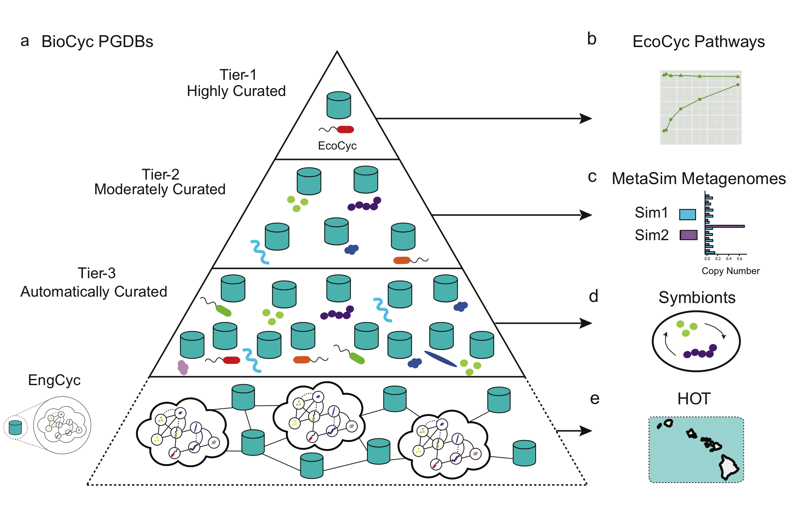
ePGDB Validation
Notes:
Pyramid figure describing the different levels of PGDB hosted by under the BioCyc umbrella and the subsequent analysis that we did at each level. ePGDBs are suggested as an extension in level-4 of the pyramid.

Slide 33
Simulated Metagenomes
Pathway recovery increases as a function of read length and sample coverage
Specificity remains high irrespective of read length or sample coverage, but sensitivity increases with both parameters
Notes:
Note: there are currently 300 base Pathways in the EcoCyc database as of March 3, 2013 (http://ecocyc.org/ECOLI/organism-summary?object=ECOLI)

Slide 34
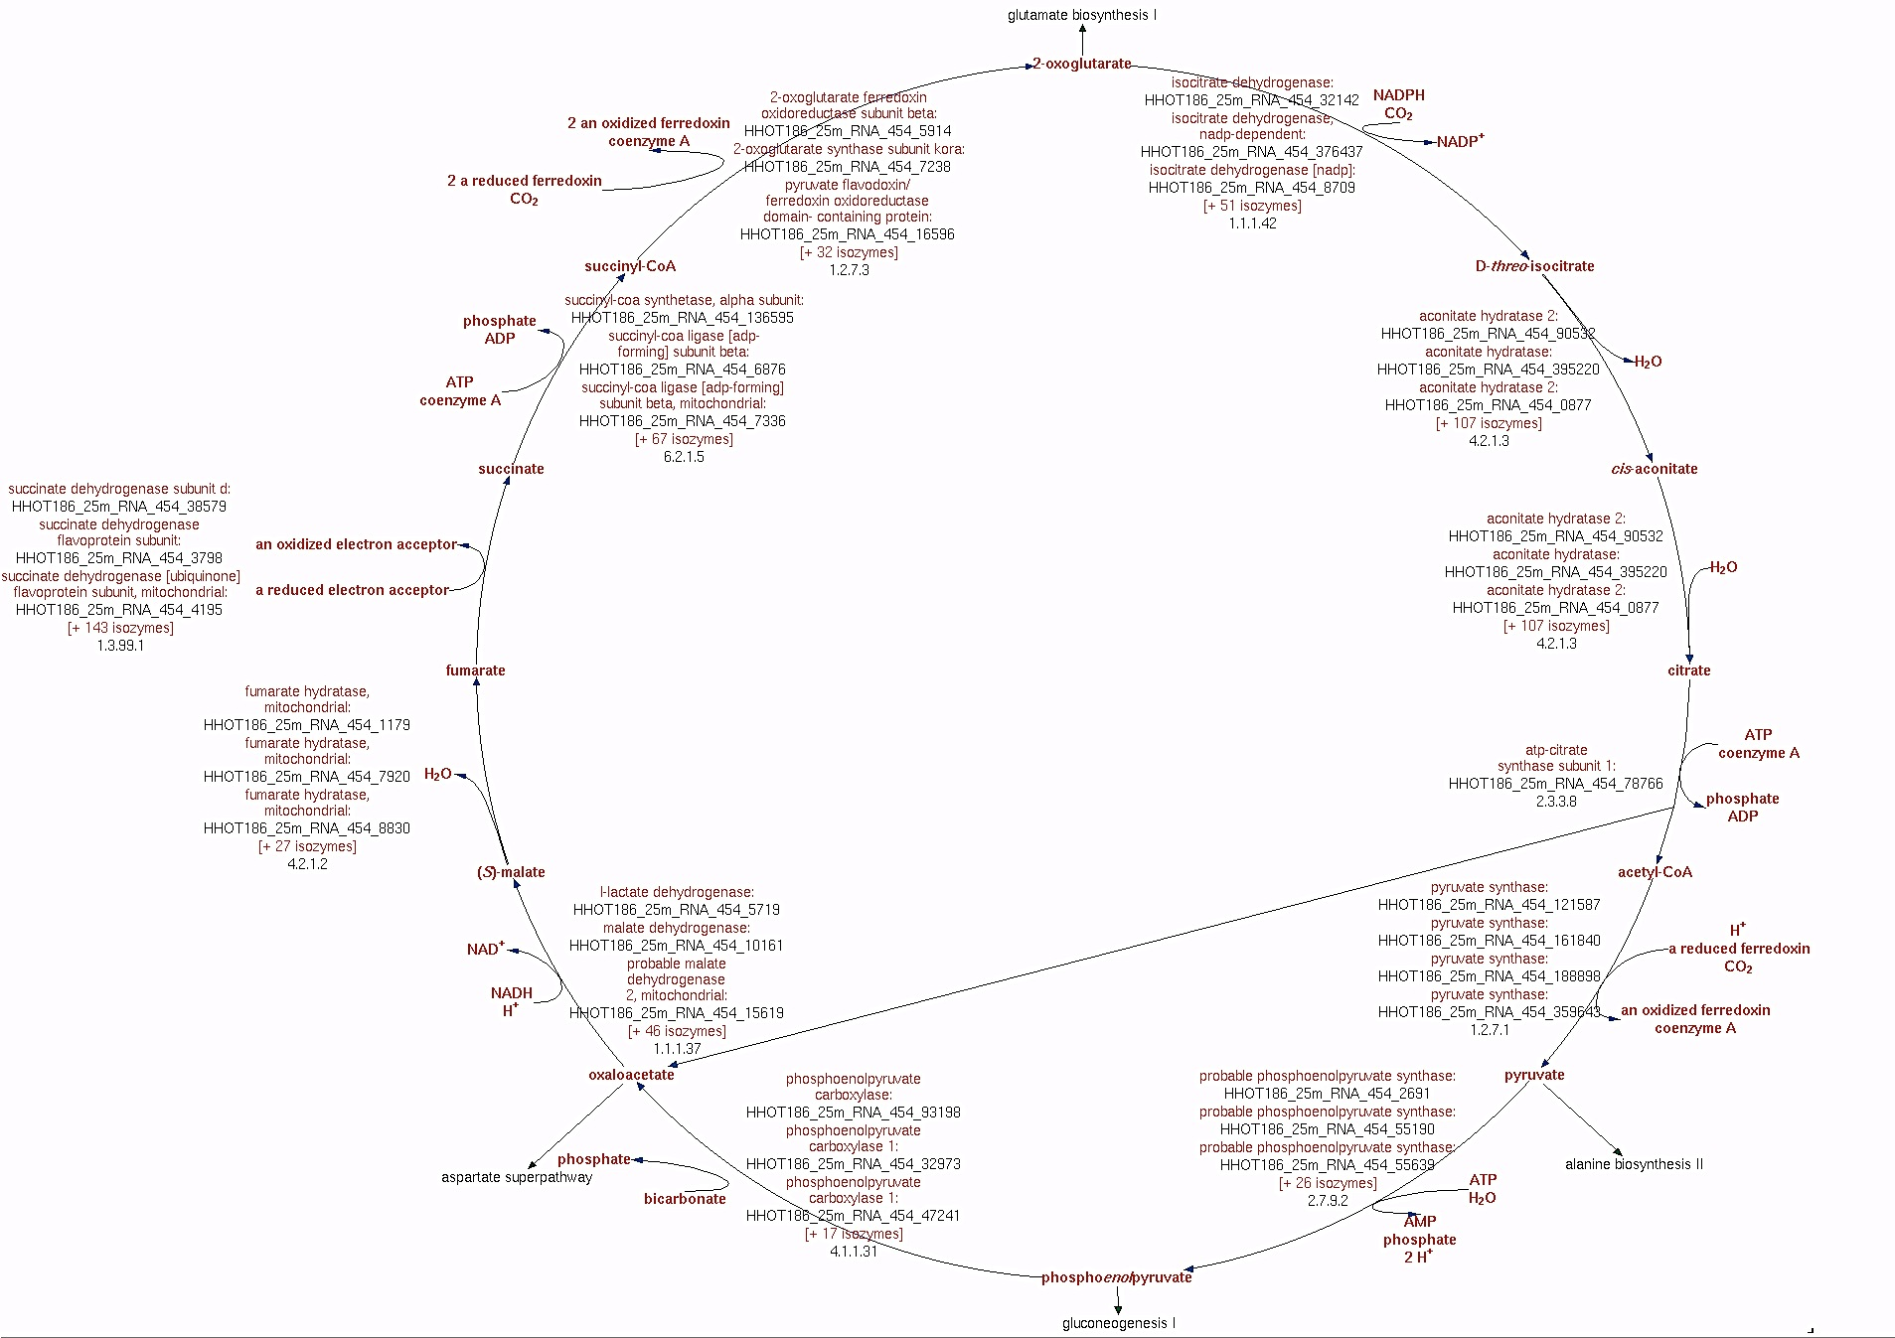
Discerning Hazards
Missing ATP citrate lyase indicates false positive for rTCA

Slide 35
Symbiotic Systems
An ePGDB constructed for the Mealybug symbionts Tremblaya princeps and Moranella endobia predicted interpathway complementarity in essential amino acid biosynthetic pathways
McCutcheon, J.P. and von Dohlen, C.D. 2011. “An interdependent metabolic patchwork in the nested symbiosis of mealybugs.” Current Biology, doi: 10.1016/j.cub.2011.06.051

Slide 36
Overview
Through the looking glass…
MetaPathways Pipeline Development
Hawaii Ocean Time Series

Slide 37
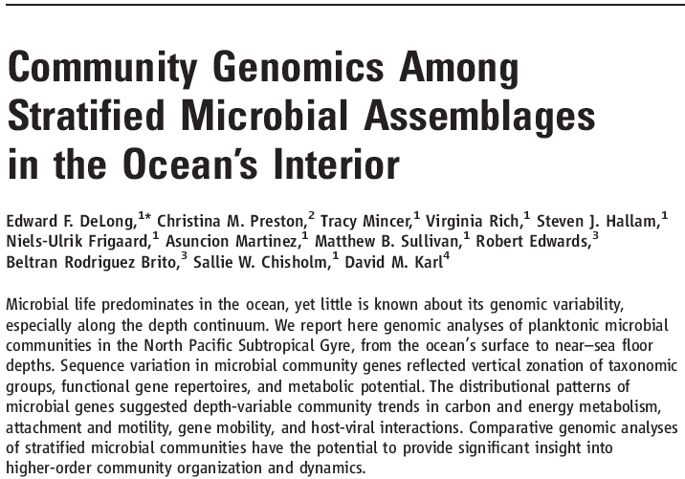

Slide 38
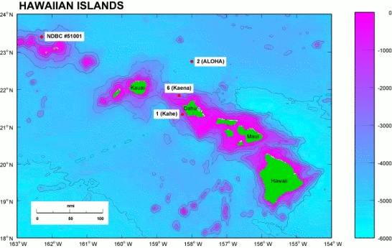
Hawaii Ocean Time Series (HOT)
http://hahana.soest.hawaii.edu/hot/hot_jgofs.html

Slide 39
Vertical Transect
Upper Euphotic
CHl Maximum
Lower Euphotic
Upper Mesopelagic
Oxygen Minimum Zone
Deep Abyss
DeLong et al. 2006. Community Genomics Among Stratified Assemblages in the Ocean’s Interior. Science 311
c1988-2013
Notes:
Temperature versus salinity (T-S) relations for the North Pacific Subtropical Gyre at station ALOHA (22-45’N, 158-W). The blue circles indicate the positions, in T-S ‘‘hydrospace’’ of the seven water samples analyzed in this study. The data envelope shows the temperature and salinity conditions observed during the period October 1988 to December 2004 emphasizing both the temporal variability of near-surface waters and the relative constancy of deep waters.

Slide 40
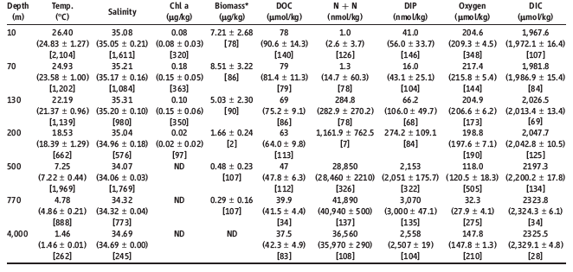
Environmental Parameters
Oceanographic parameters were measured at Station ALOHA; values shown are those from the same CTD casts used in fosmid library construction, where available.

Slide 41
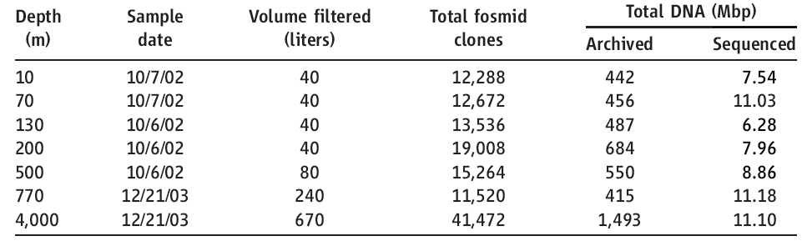
Sequencing Statistics
“The vertical distribution of microbial genes from the ocean’s surface to abyssal depths was determined by shotgun sequencing of fosmid clone termini. Applying identical collection, cloning, and sequencing strategies at seven depths (ranging from 10 m to 4000 m), we archived large-insert genomic libraries from each depth-stratified microbial community.”

Slide 43
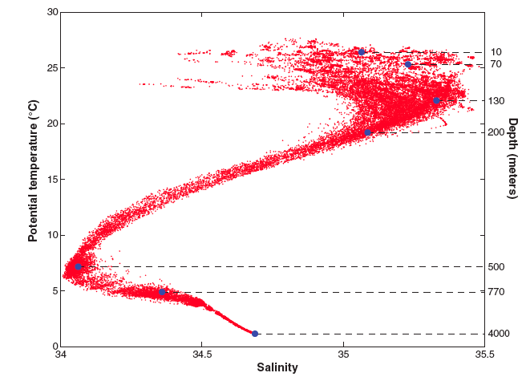
Coupled “Omic” Information
DeLong et al. 2006. Community Genomics Among Stratified Assemblages in the Ocean’s Interior. Science 311
T. Danhorn, C. R. Young, E. F. Delong, 2012. Comparison of large-insert, small-insert and pyrosequencing libraries for metagenomic analysis, ISME JJ doi:10.1038/ismej.2012.35.
c1988-2013
Notes:
Temperature versus salinity (T-S) relations for the North Pacific Subtropical Gyre at station ALOHA (22-45’N, 158-W). The blue circles indicate the positions, in T-S ‘‘hydrospace’’ of the seven water samples analyzed in this study. The data envelope shows the temperature and salinity conditions observed during the period October 1988 to December 2004 emphasizing both the temporal variability of near-surface waters and the relative constancy of deep waters.

Slide 44
HOT ePGDBs
Sample Depth (m) | Sample Description | Library Type | Sequencing Platform | Number of Sequences | Average Sequence Length | Protein Coding Sequences | Annotated Coding Sequences | MetaCyc Reactions | MetaCyc Pathways
25 | upper euphotic | DNA | Roche 454 | 623559 | 257 | 405613 | 214149 | 4138 | 864
75 | upper euphotic | DNA | Roche 454 | 673674 | 244 | 430689 | 222572 | 4052 | 854
110 | chlorophyll max | DNA | Roche 454 | 473166 | 270 | 336035 | 165775 | 4133 | 860
500 | mesopelagic | DNA | Roche 454 | 995747 | 276 | 714743 | 361193 | 4464 | 949
25 | upper euphotic | RNA | Roche 454 | 561821 | 248 | 234404 | 85781 | 3433 | 723
75 | upper euphotic | RNA | Roche 454 | 557718 | 239 | 203359 | 66855 | 3208 | 669
110 | chlorophyll max | RNA | Roche 454 | 398436 | 228 | 135107 | 36912 | 2549 | 532
500 | mesopelagic | RNA | Roche 454 | 479661 | 266 | 207465 | 71400 | 3034 | 641
Over 1,000 MetaCyc Pathways were predicted in combined DNA and RNA datasets from the HOT water column.

Slide 45
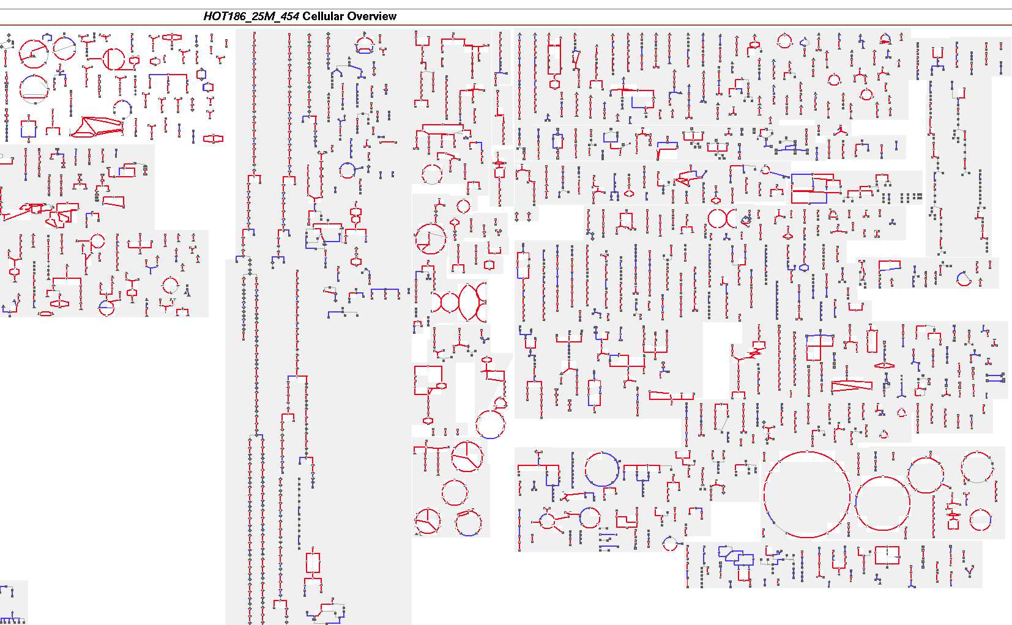
Cellular Overview
Comparison of DNA (Blue) and RNA +DNA (Red) pathway predictions

Slide 46
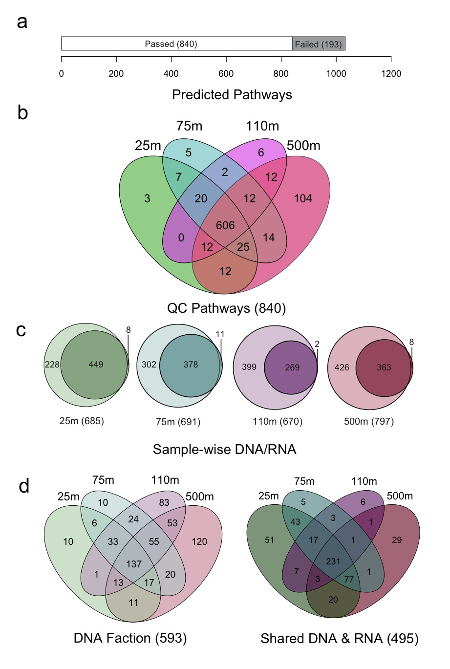
Four-way Set Difference
Core metabolic pathways and those differentially expressed between sunlit and dark ocean samples
Pathways identified in RNA but not DNA datasets

Slide 47
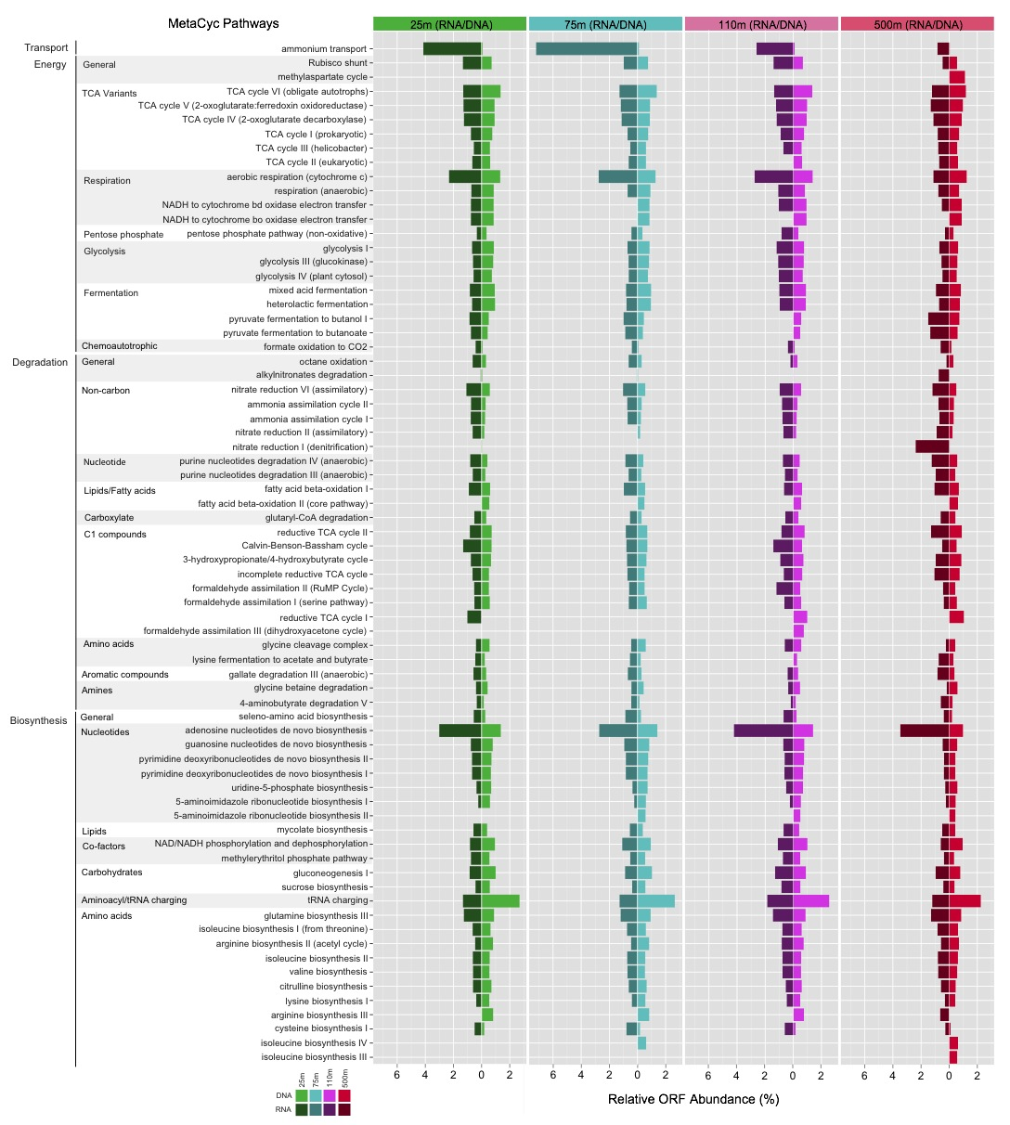
Core Pathways
Top 70 pathways in the combined DNA and RNA datasets. ORF counts shown as a two way bar plot for each depth. The order of the pathways is based on the pathway hierarchy and then by abundance across each depth interval.

Slide 48
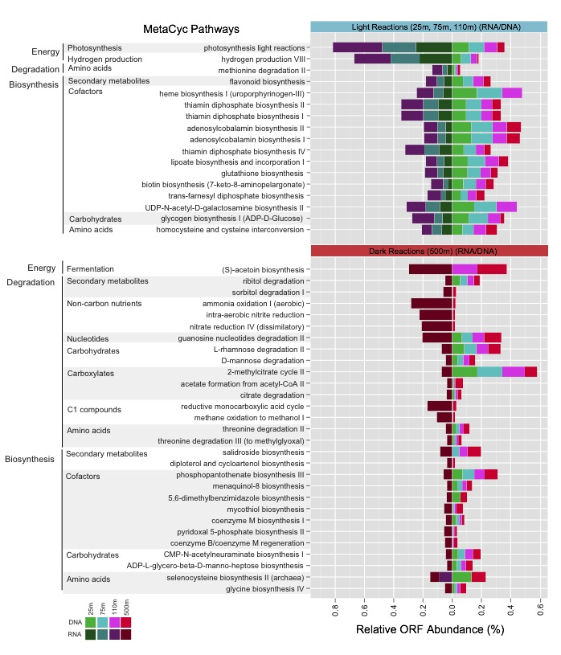
Regulated Gene Expression
A number or pathways were present throughout the water column but differentially expressed between sunlit and dark ocean waters
These included pathways for photosynthesis, hydrogen production and vitamin B synthesis in sunlit waters and pathways for organic matter degradation, ammonia oxidation and “denitrification” in dark ocean waters

Slide 49
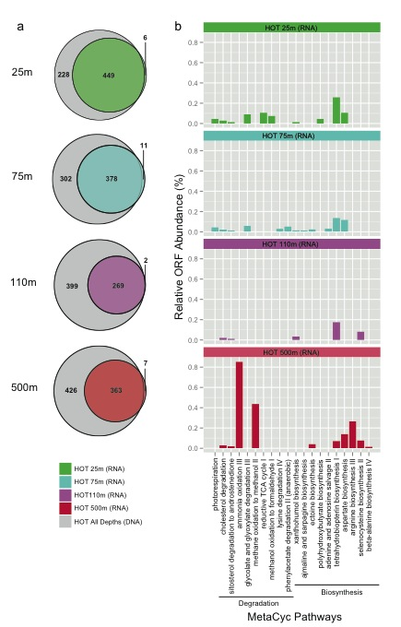
Cryptic Pathways
For each depth interval, a small number of pathways were predicted in RNA but not DNA datasets
These RNA-specific pathways including photorespiration and ammonia and methane oxidation showed depth distributions consistent with niche-partitioning between sunlit and dark ocean waters

Slide 50
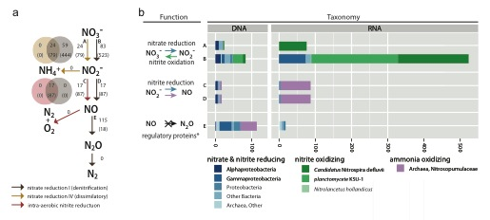
Nitrogen Cycle
a) Nitrate reduction I (denitrification) (brown), nitrate reduction IV (dissimilatory) (yellow), and intra-aerobic nitrite reduction (red). b) nitrate and nitrite reducing taxa (blue), nitrite oxidizing taxa (green), and ammonia oxidizing taxa (purple).
Notes:
(a) Nitrogen cycling pathways and reactions assigned by PathoLogic. Arrow color indicates pathway, nitrate reduction I (denitrification) (brown), nitrate reduction IV (dissimilatory) (yellow), and intra-aerobic nitrite reduction (red). Grey numbers adjacent to arrows indicated number of reads assigned to the reaction in the DNA and RNA (RNA in parentheses). Overlapping circles indicate the distribution of reads across multiple pathways. (b) BLAST-based functional and taxonomic breakdown of reads assigned to reactions in given pathways as indicated by letters A-E. Function was determined by the top RefSeq BLAST hit, reported by the MetaPathways pipeline, and indicated by reaction arrows, with color corresponding to taxa or taxonomic group with known activity: taxa with nitrate and nitrite reducing activity (blue), nitrite oxidizing activity (green), and ammonia oxidizing activity (purple). Grey reactions indicate no reads for enzymatic activity were detected, only regulatory proteins which may be involved in gene expression regulation (*).

Slide 51
Things to Keep in Mind…
Pathway Tools cannot predict pathways not present in MetaCyc
Evidence for short pathways is hard to interpret
False positives due to shared enzymes in multiple pathways or incorrect annotations create hazards
Currently no taxonomic assignment or coverage information is mapped onto identified pathways in Pathway Tools
Limited functional validation for pathways in metagenomes

Slide 52
“One gene is many hypotheses”_{Julian Davies}

Slide 53
















